Slide 1

The Future of Learning: Embracing E-Learning
E-learning is rapidly transforming education. This presentation explores the benefits, challenges, and future of online learning.

Slide 2
What is E-Learning?
Definition
Examples
E-learning, or electronic learning, refers to the use of digital technologies to facilitate and enhance learning processes.
Online courses, virtual classrooms, interactive simulations, and mobile learning apps are all forms of e-learning.

Slide 3
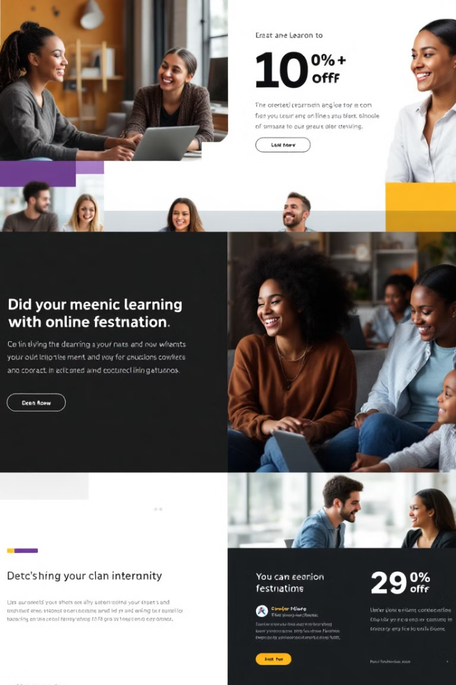
Benefits of E-Learning
Increased flexibility and accessibility
Personalized learning paths
Cost-effective and scalable
Access to a wide range of resources and experts

Slide 4




Personalized Learning Experiences
Adaptive learning platforms adjust to student progress
Personalized content recommendations cater to individual learning styles
Interactive assessments provide real-time feedback and support

Slide 5

Accessibility and Inclusivity
Remove physical barriers to access education
Provide accommodations for learners with disabilities
Promote inclusivity and equity in learning opportunities

Slide 6

Collaborative Learning Opportunities
Online forums for discussions and peer support
Virtual group projects foster teamwork and communication skills
Interactive tools enhance engagement and participation

Slide 7




Technological Advancements in E-Learning
Virtual reality for immersive experiences
Artificial intelligence for personalized learning
Gamification for engaging and interactive learning

Slide 8

Blending E-Learning with Traditional Methods
1
Hybrid learning combines online and in-person instruction
2
Flipped classrooms utilize online resources for pre-class preparation
3
Integration of technology enhances both online and offline learning

Slide 9



Challenges and Overcoming Barriers to E-Learning
Digital divide
1
Ensure equal access to technology and resources
Teacher training
2
Develop effective online teaching skills
Student engagement
3
Promote active participation and interaction

